Slide 1
Demystifying the Graduate School Application Process:
Tips for Applying to Clinical and Non-Clinical PhD
Programs in Psychology
Laurel Gabard-Durnam
Assistant Professor of Psychology
Northeastern University
Cora E. Mukerji
Assistant Professor of Psychology
Bryn Mawr College

Slide 2
These are our thoughts and opinions after navigating the PhD application. They do not reflect the views of anyone other than ourselves (e.g. not our current or past institutions). We share these thoughts in the spirit of demystifying this process and providing useful tips to others. They may not reflect the reality of this particular application cycle or your unique circumstances.

Slide 3
Welcome! People often come to these events in various levels of stress about this upcoming experience.
So, I invite you to take a minute and just breathe deeply and slowly five times to let out some tension before we get started.
One.
Two.
Three.
Four.
Five.

Slide 4
A rough application timeline
Spring/Summer
Aug - Sept
Oct
Nov - Dec
Jan - March
April
Find faculty +
programs
of interest
Email faculty
of interest
Write your personal statement +
get feedback
Applications due
Interviews
& offers
Decisions
finalized
Take the GRE, if your
programs of
interest require it*
*This is expensive
and pointless.
We are sorry.
Ask for letters
of recommendation
Tailor statements
to each school
Make a CV
Finalize list of schools
& send to letter-writers
Request your
official school
transcripts
If applicable, email
administrators at the programs you are applying to ask for application fee waivers. It does NOT hurt to ask.

Slide 5
Let’s walk through each of these steps in more detail…

Slide 6
Finding Faculty and Programs of Interest
There are many productive ways to do this, so try several!
Describe your interest in research to your faculty mentor/folks you know in academia and see if they can suggest potential options
If there are scientific papers on a topic that really grabbed your attention, look at who did /where those studies were done
Google the terms you’re interested in studying (e.g. “lab emotion regulation development adversity” and see whose websites come up
Looking at lab websites once you find them is a great way to help you narrow down your interests, too, or see who really resonates with you. Look at how the PI describes their research and their scientific questions, does that draw you in?

Slide 7
Finding Faculty and Programs of Interest
(Continued):
Visit different university department websites (e.g. Northeastern dept. of psychology) for universities you’re interested in to see who is doing interesting research, what they focus on, what the program specializes in…
Sometimes lab websites list collaborators. If you find someone interesting, check out their collaborators, too!
To further dive into people’s research focus, use scholar.google.com to look at their scientific profiles and papers (you can read some of their work to see if the way they think about problems and design studies appeals to you)
There are rankings for different psychology programs in the US… but these aren’t usually as helpful in picking programs of interest. You could look through the top 100 and get a sense of things that way. The “best” place for you to go to grad school depends on your ‘fit’ with the specific faculty mentor you want to work with (and your ‘fit’ with the type of clinical training offered, if clinical PhD) and/or other important factors like funding and your individual needs and preferences.

Slide 8
Finding Faculty and Programs of Interest
**Faculty members don’t always accept new students each year, so you want to find out if they will be taking on new mentees prior to applying, if possible**
Some folks will state if they are or are not accepting students on their websites, so google them to find their sites and check. If they say they are taking new students for your application cycle… awesome! Now you know.
Usually this will be updated in the summer before the application cycle, but sometimes not until mid-fall.
To save the cost of applying (and your time), try to find out if that faculty member of interest is NOT taking students before adding them to your list. If this information is not available on the program’s website or the faculty member’s website, you can email them to ask (more on that in just a few minutes!)

Slide 9
Finding Faculty and Programs of Interest
For clinical programs specifically, make sure to check out the information on the program website relevant to clinical accreditation & training!
It’s really important to pick programs to apply to that are APA and/or PCSAS accredited (if you’re applying in the U.S.). This becomes important later on in the process of applying for clinical internships that are required for program completion and a required step toward future licensure as a clinical psychologist!
You can find out about current accreditation, the types of classes and clinical training offered from the relevant section of the program website and/or a “Clinical Program Handbook” document posted or linked there that outlines the program philosophy and structure.
You might see certain key terms used to describe a clinical PhD program’s training philosophy:
“Scientist-practitioner” - can signal that a program aims to train psychologists that are well-rounded as both scientists and clinical practitioners
“Clinical science” - can signal that a program aims to train clinical psychologists whose work advances scientific understanding of psychopathology and its diagnosis and treatment (who are also prepared for practice!)

Slide 10
How many programs should I apply to?
Most specialties: ~10 schools if you can (at least 5)
Clinical Psychology: ~12 - 15+ (this field is particularly competitive)
Check in with your current faculty mentor or undergraduate advisor advice that is more tailored
to your specific research interests

Slide 11
Do my research interests need to be EXACTLY the same as the potential PhD mentor?
NOPE! There should definitely be significant overlap in your interests and the potential mentor’s research, but if you differ a bit or have a skillset that they don’t use yet, that could generate really exciting opportunities to ask some new research questions! It’s very rare to find a lab that offers everything you want to do, so don’t limit your list based on exact matching.
It’s also ok if you feel that two faculty members in the same program best capture your research interests, you can list them both as potential mentors in your application and describe why you’d like to work with each of them.

Slide 12
Do my research interests need to be EXACTLY the same as the potential PhD mentor?
It’s also ok to spend your PhD acquiring some of the skills/working with some of the populations of interest to you without ticking all the boxes you hope to one day as a scientist.
You can get additional skills/experiences/shift topics if you want to do post-phd research (a “postdoctoral fellowship”) or even when you start your new lab. This is true of both research and clinical experiences!
The PhD doesn’t have to fit everything in, and honestly your interests and goals may shift anyway after you spend time doing research on that PhD topic. Go easy on yourself… you don’t need to have every step of your future research program and/or clinical repertoire planned out now… keep an open mind about where you might head and what else you might focus on in the future!

Slide 13
Emailing faculty of interest
You will work primarily with 1-2 faculty members for your PhD. Most programs have faculty pick the individual applicants they want to interview and admit, so you want to try get on specific faculty’s radar by emailing them.
Best to email faculty in Aug- Sept, but if you haven’t yet, go ahead and reach out! You can also acknowledge that you have only recently learned reaching out to professors is encouraged.
Make sure to check over the information available online about the program, the mentor’s capacity to take new students, etc. in order to avoid asking questions about information that is readily available.
Some professors will not reply! It’s not a reflection on you or your promise as an applicant… Professors get a LOT of emails and may or may not have the bandwidth to respond at that particular moment :)

Slide 14
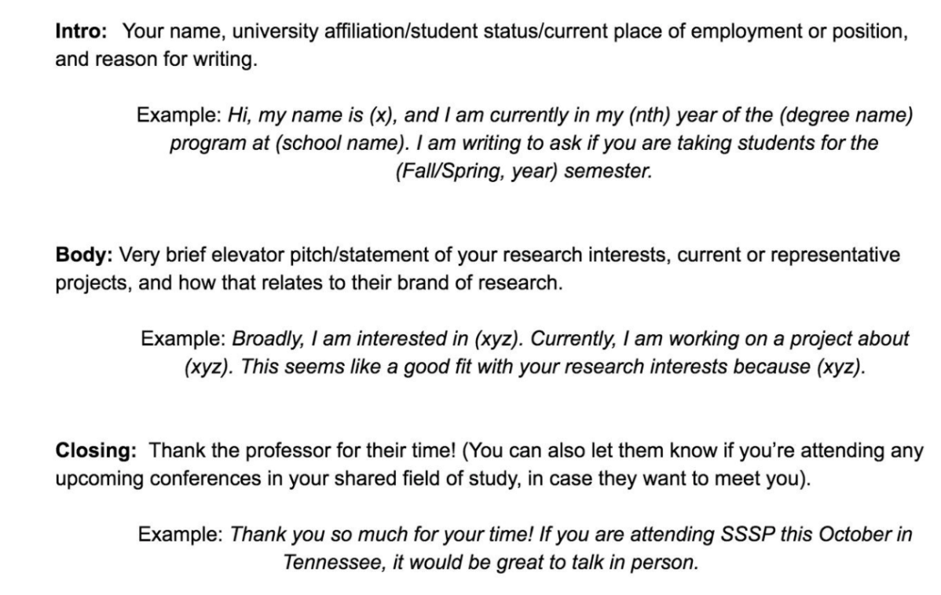
Emailing faculty of interest

Slide 15
Emailing faculty of interest
Dear Professor/Dr. _______,
My name is _______ and I am a rising senior/lab manager/post-bac research assistant at _______ college/university. I am currently working under the direction of _______ studying _______(e.g. the effects of environmental factors like poverty on childhood brain development). (if applicable: I am conducting/have conducted an honors thesis project on _______.)
I will be applying to Ph.D. programs this fall in ________ and hope to focus on ______. I am very interested in your research on _____ and how this relates to _____. I am particularly curious about _____. I am writing to inquire if you will be accepting graduate students for entry in 20xx?
Thank you for your consideration.
Sincerely,

Slide 16
What if the faculty wants to meet/have a phone interview after I email them?
Great! That’s a positive sign, if that faculty member does preliminary phone/Zoom interviews
(not everyone does!)
Tips on navigating that initial interview process can be found here:
https://drive.google.com/file/d/1Deaf6zmXxVQoTj-XvvkpSqmXdgUC5uqY/view

Slide 17
Emailing to ask for waivers!
Some programs will explain how to request an application fee waiver for financial hardship on their website
(hooray for transparency!) This may involve emailing an administrator for the program to request a code.
Other programs will not put this information on their websites (rawr). This doesn’t always mean that they will not
consider free waivers, so ask!
Really, it doesn’t hurt to email the administrator for the program (often listed on the department website/information for applicants section) and ask. You can also ask the director of graduate studies for the program, the department chair, or your faculty member of interest. (Remember to be polite and kind to anyone you interact with… in life, and throughout this process!)
Example email text: The application fee of [$] presents an economic hardship given my current situation. (You can elaborate as much or as little on that situation as you feel comfortable doing.) Since your program is one of my top choices, I would like to know if you offer a fee waiver? If so, who should I contact to learn more about the process? Thank you for your time and help!

Slide 18
Asking for Letters of Recommendation
It’s ok to email folks you haven’t talked to in a while (maybe don’t ask someone you haven’t seen in 8 years, but 1-3 years is common).
Sample structure of email to ask someone to write (via Monica Aswani):
[Introduction sentence(s) about future plans and why you believe this person can speak to your ability to pursue them.] Would you feel comfortable providing me a positive letter of recommendation for my application to [program]? If you are willing, I am happy to provide a package of relevant documents, including my CV and application statement before the deadline of [date].
If they ask you what info about yourself that you’d like them to include, (or if you’d like to share ideas with them that they can include if they think that will help), think about the following questions to guide your response (via Kimberly Manning):
* WHAT are my strongest attributes? What am I MOST proud of about myself? * WHAT have I done that could set me apart from other applicants? What is my unique strength? * HOW would my peers describe me? What makes me a good teammate? * WHAT would I want to MAKE SURE programs knew that I have done? * WHAT hardships (if you are willing to share) might cause you to be misunderstood? (optional)

Slide 19
Asking for letters of Recommendation
Who to ask? You’ll want someone, and ideally most of your letter writers, to be folks in the academic system. They
Can speak to what this system values and how you would contribute. Also, They know what these letters should look like
And what should be included generally speaking.
People you can ask: faculty you currently work for, faculty you previously worked for, your college academic advisor, a faculty mentor for a student group you were really involved with during college, a professor from a small class where you got to be known as an individual, a professor who taught multiple classes of yours, grad student/postdoc you worked with in a lab (they might co-write a letter with the lab PI for you), this is not an exhaustive list.
Don’t ask the fancy-pants professor from your school if they don’t know you. They may be mega-famous, but if all they can say is “this person was in my class in 2019 and they got an A.” it’s not going to help you.
The letter writers don’t need to be in the exact field you’re interested in! I had neurobiology folks writing for me for psychology (and a Celtic Literature professor write for me). But try to ask folks as close to your general area (psych) as you can (though someone who knows you well and will write a strong letter >>> someone in the field who knows you much less well).

Slide 20
Writing your “personal” statement
**Your personal statement for a PhD program is very different from what you might have written to apply for undergraduate! It is only somewhat “personal”… in the sense that it describes your goals for graduate training, how your previous experiences have shaped your preparedness and commitment to pursuing a PhD in a specific field of psychology, and your ‘fit’ with a specific program**
Introduction paragraph: What do you want to focus on in research? Why is it an important topic? (For clinical applicants, also indicate that you are interested in and committed to clinical work!)
Body of statement: How did you come to want to focus on this research topic/ Why do you want to complete further research in this field? How did your experiences/schooling prepare you for this research? (For clinical applicants, also describe relevant experience with clinical populations and the skills you have developed)
Body of statement: UNPACK the CV! What did you learn, really appreciate, gain in terms of skills or interests, found compelling about each of your experiences? Show us what you took from that experience, not just what you did while you were there.
Final paragraph: Modify the final paragraph in each application: Why have you chosen to apply to this particular faculty member/program/university? (For clinical applicants, also mention what about their clinical training model/opportunities appeals to you?)

Slide 21
Writing your personal narrative: unpacking your CV
Tips:
Try not to rewrite your CV (in 2018 I did x, then in 2019 I did y at Z place. Now I want to join W to do …)
INSTEAD, write what did you learn, come to appreciate, gain in terms of skills or interests with each of your experiences? Show us what you took from that experience, not just what you did while you were there.
In early drafts, common to write too much about WHAT you did, rather than:
what you learned,
WHY that mattered,
HOW that led you to your next step (either what didn’t work for you about that experience/topic, or how did you want to build on it)
Convey your scientific curiosity. Include questions in your statement. (e.g. Learning about x topic made me wonder why thing x does y? So I sought out an opportunity to explore this question by joining W thing/lab/ ….) You can say things like “this experience made me curious to learn ….” to broadcast that trait
Say what you learned from each experience not just what you did…(e.g. although the behavior responses were the same across people, I learned how focusing on neural mechanisms could differentiate these individuals with implications for targeted clinical treatment.)

Slide 22
Writing your personal narrative
Your narrative should address:
1. Why do you want to complete further research in this field, and how did you come to that decision? Bulk of the statement is addressing these questions. Write down a list of reasons as to why you are interested in pursuing further study in the field. When did you become interested in the field and what knowledge have you gained so far? Describe how your previous work provided the foundation and pathway for further study. (For clinical applicants, address how your experiences have shaped your commitment to obtaining clinical training!)
Adapted from Purdue U.

Slide 23
Writing your personal narrative
Your narrative should address:
2. What are your strengths/how have you prepared for graduate study? (sprinkle these throughout the statement) Demonstrate how you stand out from other candidates but also showcase your collaborative skills as part of a scientific team. Highlight relevant projects, dissertations thesis or essays that demonstrate your academic skills and creativity. Include statistical and/or programming skills, research techniques, awards, or other relevant experiences as part of your narrative. (For clinical applicants, also describe how your prior experiences have shaped your clinical skills and desire for further training!)
Adapted from Purdue U.

Slide 24
Writing your personal narrative
Your narrative should address:
3. Why have you chosen to apply to this particular faculty member/program/university? (end the statement addressing this question) Talk about your fit with the specific faculty member you want to work with, including what YOU can bring/add to their program of research. Does the program have a focus on the kind of work you want to do? (look at the dept website to see if they list special emphases for their research or Centers on a specific topic) Does the institution have a particular curriculum, special research facilities/equipment, or interesting research that appeal to you? (For clinical applicants, what appeals to you about the program’s clinical training model and/or opportunities? How does this match up with your professional goals with respect to clinical science and practice? Will you be working with clinical populations or diagnosis/treatment approaches that are of interest to you?)
Adapted from Purdue U.

Slide 25
Try to access sample personal narratives
It can be REALLY helpful to look at examples of other people’s personal narratives to see how they are constructed.
If you know someone who has gone to graduate school, ask if they would share their personal narrative with you
(if you work in a lab, you can ask the graduate students in that lab, for example)
Also, here is a free online example of the personal narrative for someone who has gone on to be faculty:
http://theramirezgroup.org/resources
***If any of you feel comfortable sending me your personal narrative after you apply this year, I’d love to feature more on my
website for other students to see as examples in years to come. You could help many future students!
Please email me if you’d be willing to share? (l.gabard-durnam@northeastern.edu)

Slide 26
Making a CV
For templates and instructions, see following examples:
https://wordvice.com/how-to-write-a-flawless-cv-curriculum-vitae-for-graduate-school/
https://www.plasticityinneurodevelopmentlab.com/s/Gabard-Durnam_CV_2019-1.doc
https://grad.illinois.edu/sites/default/files/pdfs/cvsamples.pdf (made for professors, but applicable to you, too!)
List your research experiences (if you’ve worked in a lab, for example) right after your educational information so we can see what you’ve had the opportunity to do so far!
Plan to send your CV to your academic or science mentor/advisors to get feedback on your formatting and information included, it’s important!

Slide 27
Funding differs between schools and programs!
When you consider programs, check the program/university webpage for the funding they provide students in their phd programs.
Reputable phd programs worth going to will pay YOU to attend them as a stipend.
Some programs only guarantee pay for 9 months of the year (during the school year) with opportunities to teach or apply for grants to fund the 3 summer months
Other programs pay you 12 months stipend the whole year.
All programs should cover your 5-6 years of the PhD with funding.
But not all stipends go the same distance depending on cost of living. It is very expensive to live in cities like NYC and Boston!
Stipends usually range from $27,00 to $42,000 /year, and should also come with healthcare benefits (which will vary tremendously by state).
When you go to a graduate school interview, you can and should ask about the stipend and whether current students feel it is sufficient for living in that place!

Slide 28
Remember

Slide 29
Questions about finding and applying for programs?

